Slide 1
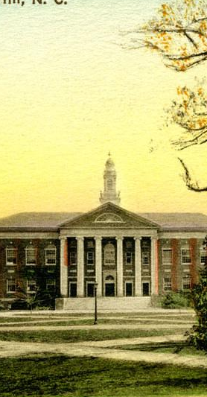
Availability of Menstrual Products in the Bathrooms on North Campus
Duaa Alzouby, Iman Amadou, Gwyneth Parthemore

Slide 2
Problem Addressed and Our Claims
Accessibility
Convenience
Identifying Gaps
Need for equal access for students and faculty
Affordability is a huge issue
Basic need by many
Rising cost of living makes affording basic needs harder
There should be ease to get menstrual products around campus regardless of where you are
Identify which buildings on north campus are missing menstrual products
We found many buildings in the most populous areas had little or no menstrual products

Slide 3
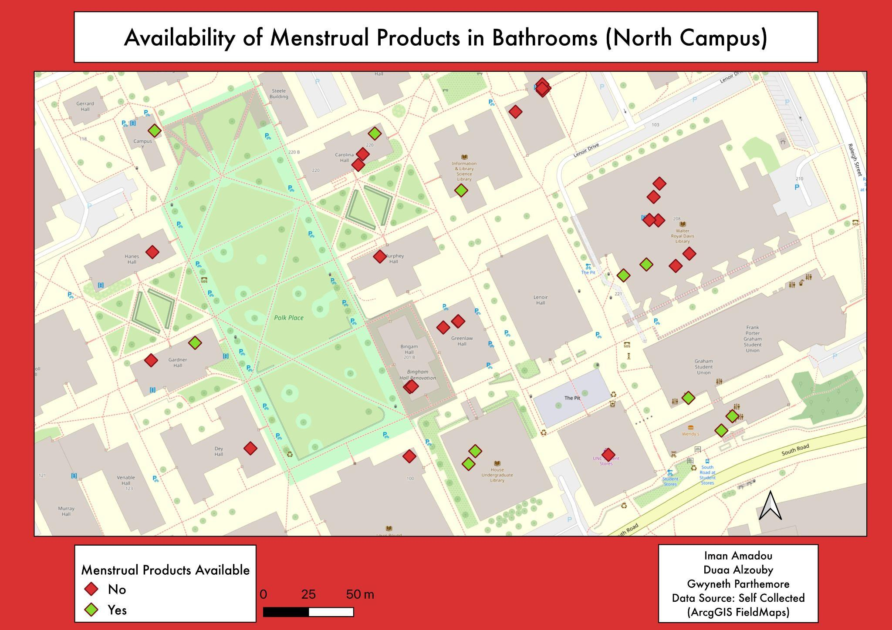
Notes:
For our countermap we collected 35 features across UNC’s North Campus Bathrooms.
This map orients the viewer to consider the spatial availability of menstrual products, which reinforces our argument that period products are not equally available for students and staff who experience periods.
Buildings with the highest foot traffic such as Lenoir dining hall and Davis Hall had gaps in avawhere menstrual product availability is either non existent or unequal across floors.
This poses an ADA issue of having to climb floors or find elevators if there are menstrual products on 1st or 2nd floors.
By having availibily be the main argument of the map we are encourage the viewer to consdier the barriers that people who experience periods might have, especially considering the financial burden of purchasing period products or having to find them on campus, considering their uneven availability across campus.
We also wanted to highlight that during our data collection phase we noticed that many of the bathrooms had baskets for menstrual products but the containers were emptied – stressing the demand for these products and how concentrating them in a few buildings leads to scarcity.

Slide 4
Map Design
Red Border
Binary Legend
Red vs Green
Basemap
Reinforces urgency and highlights the mainly red diamonds that signify no menstrual products
Simple yes/no classification to make our argument clear
The color choice: red indicates absence while green signals access
The light street basemap orients viewers without being overwhelming, it only has:
  Building outlines
  Building names
  Road names
Notes:
Every design choice on this map was made to serve the argument.
Starting with color: red and green are immediately readable.
Red signals absence and urgency, green signals access, and you can immediately see there is an imbalance.
The red border reinforces that same urgency and visually ties the frame back to the dominant story the data is telling.
For the basemap, we chose a light street map that gives you just enough context: you can see building outlines, names, and roads : but it stays in the background so your eye goes straight to the data points.
And finally, the legend is binary meaning Yes or no, products or no products.
We could have added categories like 'some products' or 'dispensers only,' but keeping it simple makes the claim and pattern more clear

